Slide 1
Lists (Chapter 12, 13 & 14) Dictionaries (Chapter 19 & 20)
Manar Mohamed
mohamem@miamioh.edu

Slide 2

Lists
A way to organize data
Examples
To-do list
Gift lists
Grocery Lists
Items in list have position
May or may not be important
Items may be added anywhere

Slide 3
Specifications for the ADT List
add(newEntry)
add(newPosition, newEntry)
remove(givenPosition)
clear()
replace(givenPosition, newEntry)
getEntry(givenPosition)
toArray()
contains(anEntry)
getLength()
isEmpty()

Slide 4
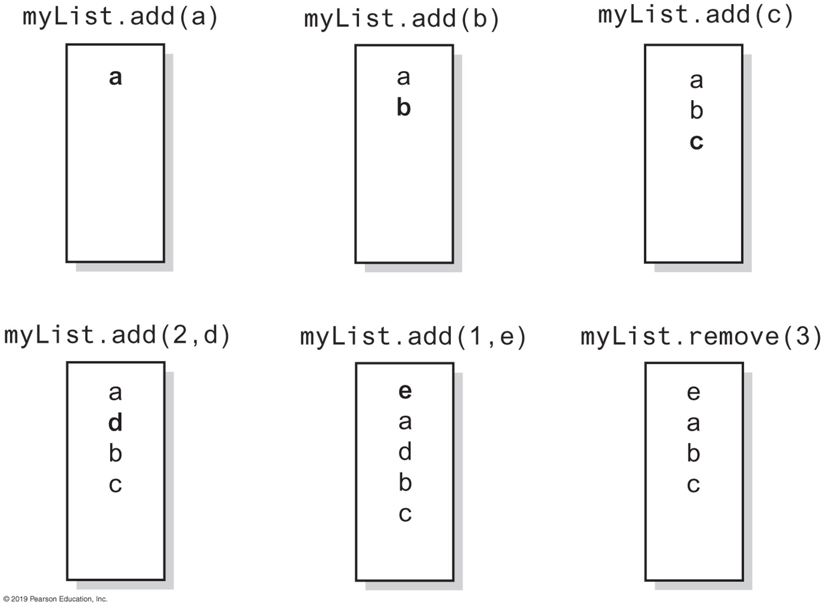
Specifications for the ADT List

Slide 5
Specifications for the ADT List
Data
A collection of objects in a specific order and having the same data type
The number of objects in the collection
Pseudocode | UML | Description
add(newEntry) | +add(newEntry: T): void | Task: Adds newEntry to the end of the list. Input: newEntry is an object. Output: None.
add(newPosition, anEntry) | +add(newPosition: integer, anEntry: T): void | Task: Adds newEntry at position newPosition within the list. Position 1 indicates the first entry in the list. Input: newPosition is an integer, newEntry is an object. Output: Throws an exception if newPosition is invalid for this list before the operation.
remove(givenPosition) | +remove(givenPosition: integer): T | Task: Removes and returns the entry at position givenPosition. Input: givenPosition is an integer. Output: Either returns the removed entry or throws an exception if givenPosition is invalid for this list. Note that any value of givenPosition is invalid if the list is empty before the operation.
clear() | +clear(): void | Task: Removes all entries from the list. Input: None. Output: None.
replace(givenPosition, anEntry) | +replace(givenPosition: integer, anEntry: T): T | Task: Replaces the entry at position givenPosition with newEntry. Input: givenPosition is an integer, newEntry is an object. Output: Either returns the replaced entry or throws an exception if givenPosition is invalid for this list. Note that any value of givenPosition is invalid if the list is empty before the operation.

Slide 6
Specifications for the ADT List
Data
A collection of objects in a specific order and having the same data type
The number of objects in the collection
Pseudocode | UML | Description
getEntry(givenPosition) | +getEntry(givenPosition: integer): T | Task: Retrieves the entry at position givenPosition. Input: givenPosition is an integer. Output: Either returns the entry at position givenPosition or throws an exception if givenPosition is invalid for this list. Note that any value of givenPosition is invalid if the list is empty before the operation.
toArray() | +toArray: T[ ] | Task: Retrieves all entries that are in the list in the order in which they occur. Input: None. Output: Returns a new array of the entries currently in the list.
contains(anEntry) | +contains(anEntry: T): boolean | Task: Sees whether the list contains anEntry. Input: anEntry is an object. Output: Returns true if anEntry is in the list, or false if not.
getLength() | +getLength(): integer | Task: Gets the number of entries currently in the list. Input: None. Output: Returns the number of entries currently in the list.
isEmpty() | +isEmpty(): boolean | Task: Sees whether the list is empty. Input: None. Output: Returns true if the list is empty, or false if not.

Slide 7
Java Class Library: The Interface List
Method headers from the interface List
public void add(int index, T newEntry)
public T remove(int index)
public void clear()
public T set(int index, T anEntry) // Like replace
public T get(int index) // Like getEntry
public boolean contains(Object anEntry)
public int size() // Like getLength
public boolean isEmpty()

Slide 8
Java Class Library: The Class ArrayList
Available constructors
public ArrayList()
public ArrayList(int initialCapacity)
Similar to java.util.vector
Can use either ArrayList or Vector as an implementation of the interface List.
https://www.geeksforgeeks.org/vector-vs-arraylist-java/

Slide 9
Using an Array to Implement the ADT List
AList
–list: T[] –numberOfEntries: integer –DEFAULT_CAPACITY: integer –MAX_CAPACITY: integer
+add(newEntry: T): void +add(givenPosition: integer, newEntry: T): void +remove(givenPosition: integer): T +clear(): void +replace(givenPosition: integer, newEntry: T): T +getEntry(givenPosition: integer): T +toArray(): T[] +contains(anEntry: T): boolean +getLength(): integer +isEmpty(): boolean
FIGURE 11-3 UML notation for the class AList

Slide 10
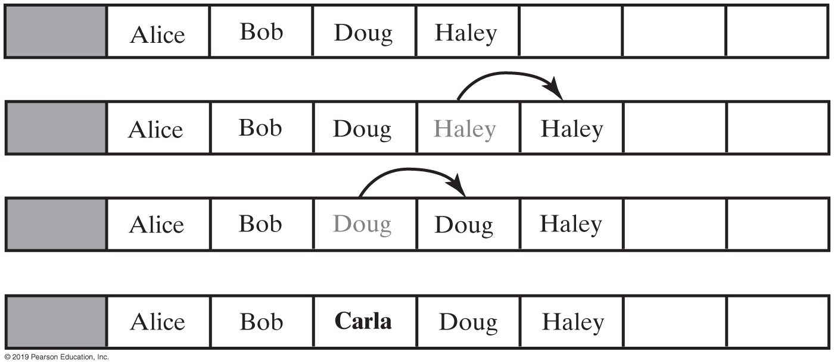
Using an Array to Implement the ADT List
FIGURE 11-4 Making room to insert Carla as the third entry in an array

Slide 11
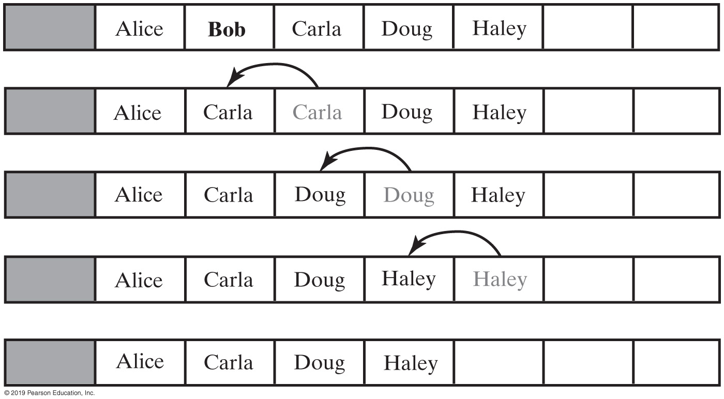
Using an Array to Implement the ADT List
FIGURE 11-5 Removing Bob by shifting array entries

Slide 12
Advantages of Linked Implementation
Uses memory only as needed
When entry removed, unneeded memory returned to system
Avoids moving data when adding or removing entries

Slide 13
Adding a Node at Various Positions
Possible cases:
Chain is empty
Adding node at chain’s beginning
Adding node between adjacent nodes
Adding node to chain’s end

Slide 14
Removing a Node
Possible cases
Removing the first node
Removing a node other than first one

Slide 15
Efficiency of Using a Chain
Operation | Alist | LList | LListWithTail
add(newEntry) | O(1) | O(n) | O(1)
add(givenPosition, newEntry) | O(n); O(n); O(1) | O(1); O(n) | O(1); O(n); O(1)
toArray() | O(n) | O(n) | O(n)
remove(givenPosition) | O(n); O(n); O(1) | O(1); O(n) | O(1); O(n)
replace(givenPosition, newEntry) | O(1) | O(1); O(n) | O(1); O(n); O(1)
getEntry(givenPosition) | O(1) | O(1); O(n) | O(1); O(n); O(1)
contains(anEntry) | O(n) | O(n) | O(n)
clear(), getLength(), isEmpty() | O(1) | O(1) | O(1)
FIGURE 12-11 The time efficiencies of the ADT list operations for three implementations, expressed in Big Oh notation

Slide 16
Java Class Library: The Class LinkedList
Implements the interface List
LinkedList defines more methods than are in the interface List
You can use the class LinkedList as implementation of ADT
queue
deque
or list.

Slide 17
Dictionaries

Slide 18

Dictionaries
When you want to look up …
The meaning of a word
An address
A phone number
A contact on your phone
These can be implemented in an ADT Dictionary

Slide 19
Specifications for the ADT Dictionary
Synonyms for ADT Dictionary
Map
Table
Associative array
An entry in the dictionary contains
Keyword, search key
Value

Slide 20
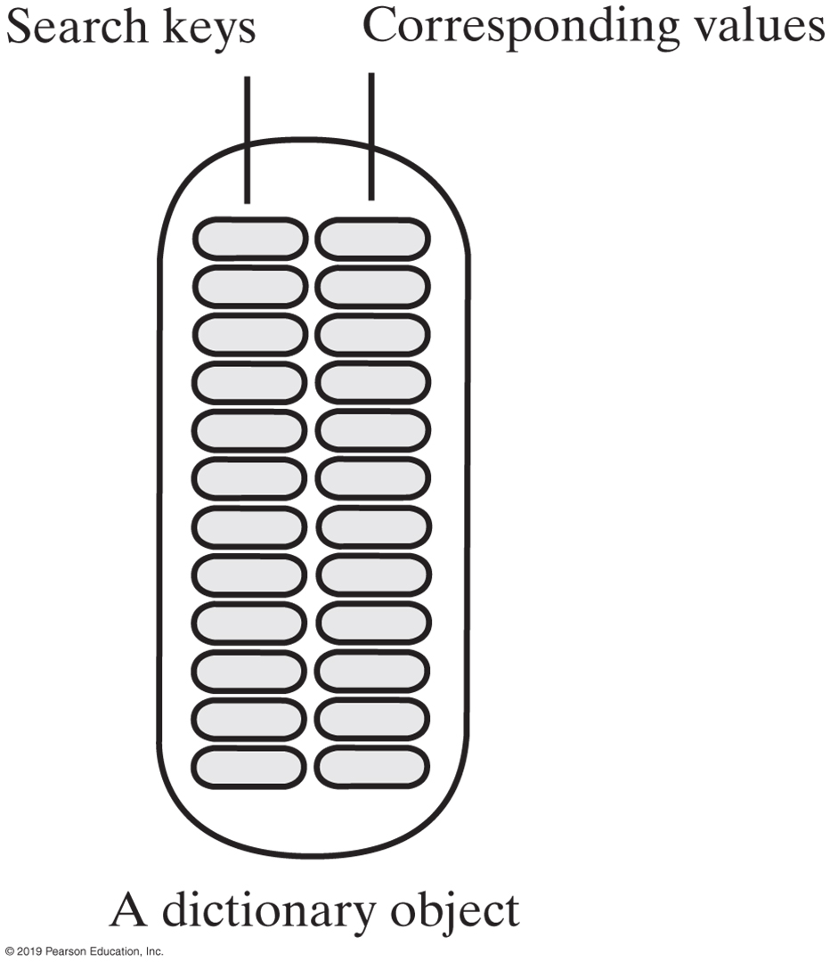
Specifications for the ADT Dictionary
Dictionary Data
Collection of pairs (k, v) of objects k and v,
k is the search key
v is the corresponding value
Number of pairs in the collection
FIGURE 19-2 An instance of the ADT dictionary has search keys paired with corresponding values

Slide 21
Specifications for the ADT Dictionary
Operations
add(key, value)
remove(key)
getValue(key)
contains(key)
getKeyIterator()
getValueIterator()
isEmpty()
getSize()
clear()

Slide 22
Dictionary Iterators
Options for dictionary iterators
Can use each of these iterators either separately or together to traverse:
All search keys in a dictionary without traversing values
All values without traversing search keys
All search keys and all values in parallel
Iterator<String> keyIterator = dataBase.getKeyIterator();
Iterator<Student> valueIterator = dataBase.getValueIterator();

Slide 23
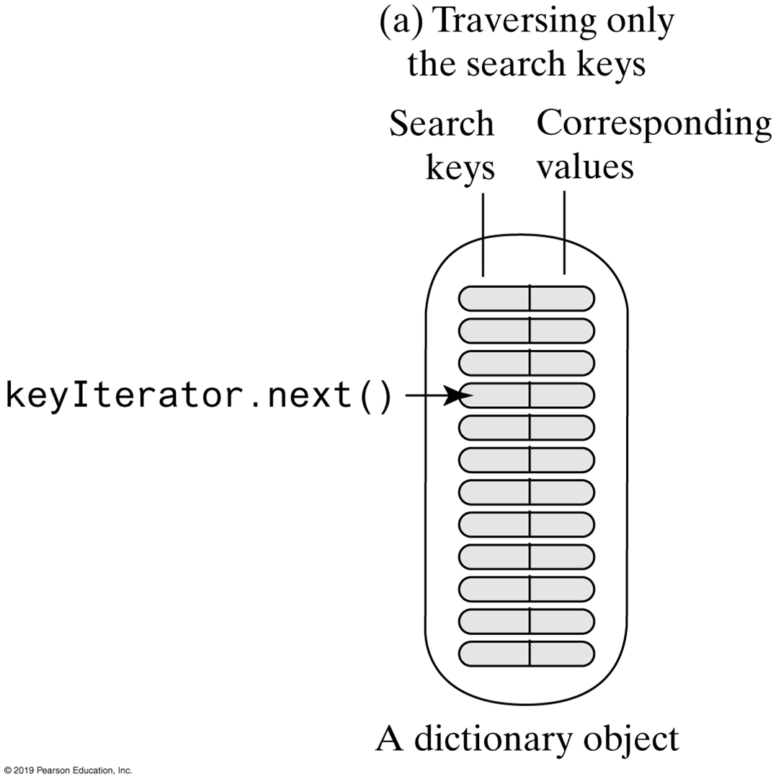
Dictionary Iterators
FIGURE 19-3a Traversing a dictionary’s keys separately

Slide 24
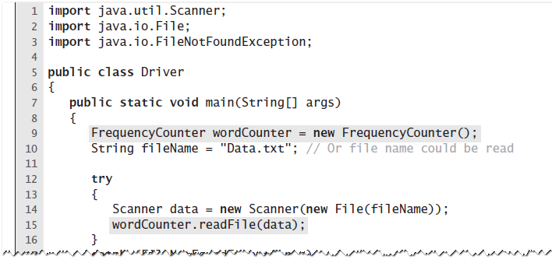
The Frequency of Words
To provide a count of the number of times each word occurs in a document … LISTING 19-4 A client of the class FrequencyCounter

Slide 25
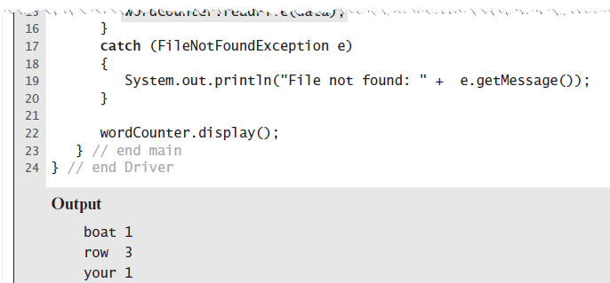
The Frequency of Words
To provide a count of the number of times each word occurs in a document … LISTING 19-4 A client of the class FrequencyCounter

Slide 26
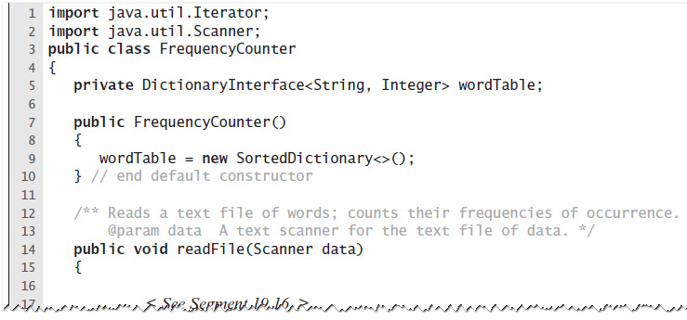
The Frequency of Words
LISTING 19-5 An outline of the class FrequencyCounter

Slide 27
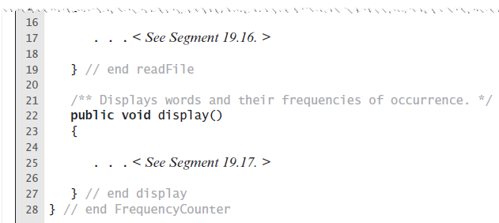
The Frequency of Words
LISTING 19-5 An outline of the class FrequencyCounter

Slide 28
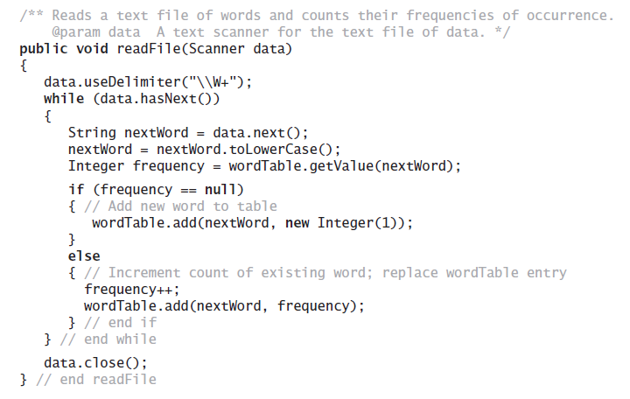
The Frequency of Words
Implementation of the method readFile

Slide 29
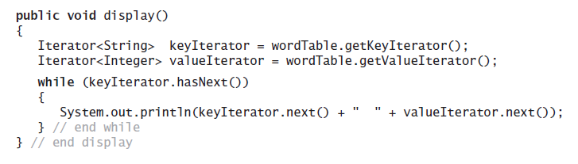
The Frequency of Words
Method to display the dictionary

Slide 30
Java Class Library: The Interface Map
public V put(K key, V value);
public V remove (Object key);
public V get(Object key);
public boolean containsKey(Object key);
public boolean containsKey(Object value);
public Set<K> keySet();
public Collection<V> values();
public boolean isEmpty();
public int size();
public void clear();
Method headers for a selection of methods in Map
Highlighted methods differ from our method implementations.

Slide 31
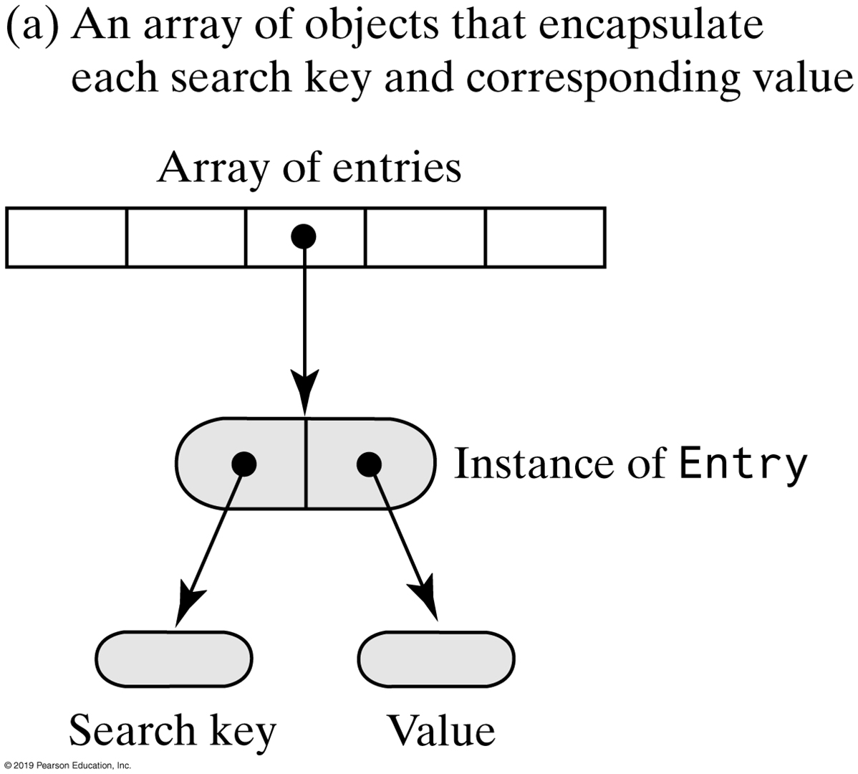
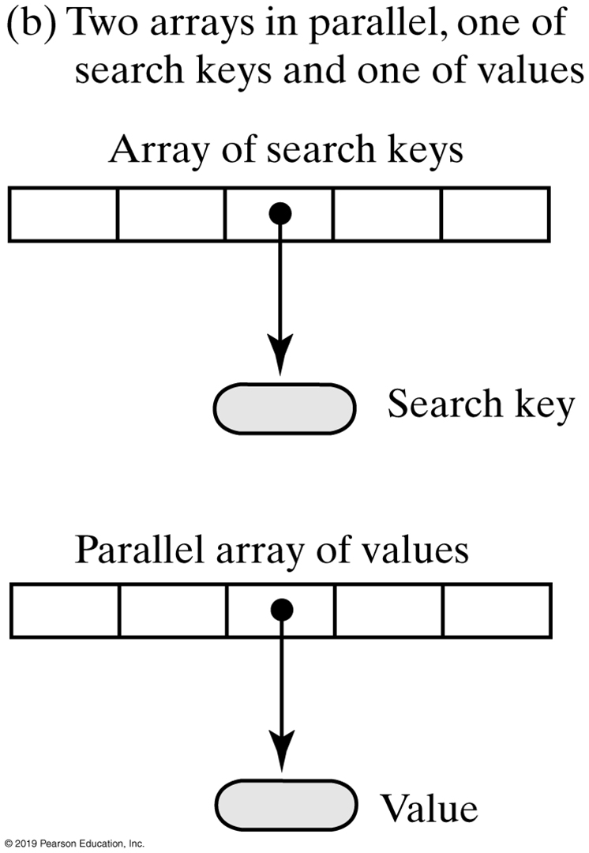
Array-Based Dictionaries
FIGURE 21-1 Two possible ways to use arrays to represent the entries in a dictionary

Slide 32
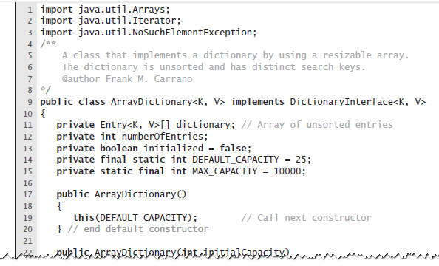
Array-Based Implementations
LISTING 20-1 The class ArrayDictionary and its private inner class Entry

Slide 33
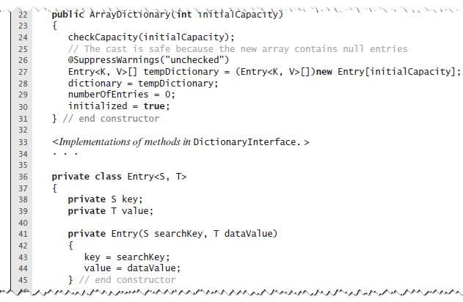
Array-Based Implementations
LISTING 20-1 The class ArrayDictionary and its private inner class Entry

Slide 34
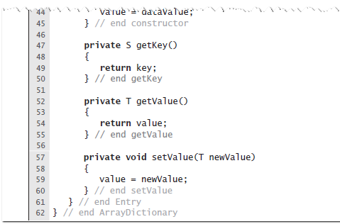
Array-Based Implementations
LISTING 20-1 The class ArrayDictionary and its private inner class Entry

Slide 35
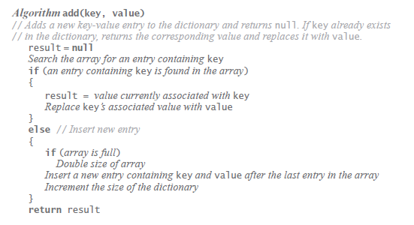
Array-Based Implementations
Algorithm to add an entry.

Slide 36
Array-Based Implementations
Algorithm to add an entry.

Slide 37
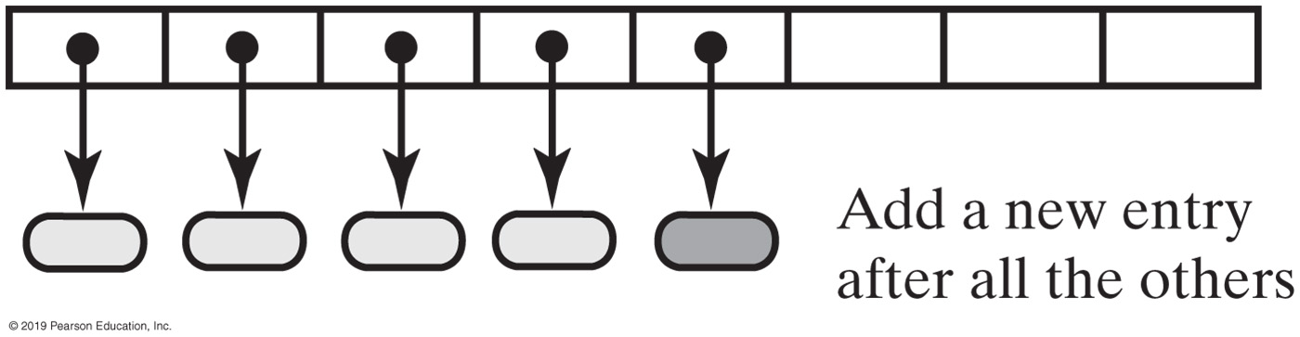
Unsorted Array-Based Implementations
FIGURE 21-2 Adding a new entry to an unsorted array-based dictionary

Slide 38
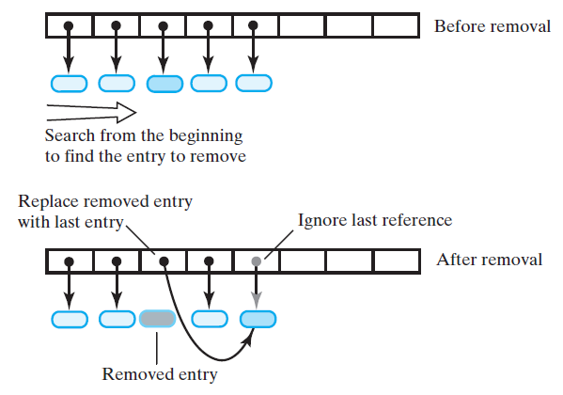
Array-Based Implementations
FIGURE 20-3 Removing an entry from an unsorted array-based dictionary

Slide 39
Array-Based Implementations
FIGURE 20-3 Removing an entry from an unsorted array-based dictionary

Slide 40
Array-Based Implementations
FIGURE 20-3 Removing an entry from an unsorted array-based dictionary

Slide 41
Array-Based Implementations
Efficiency: for this implementation, the worst-case efficiencies of the operations.
Addition O(n)
Removal O(n)
Retrieval O(n)
Traversal O(n)

Slide 42
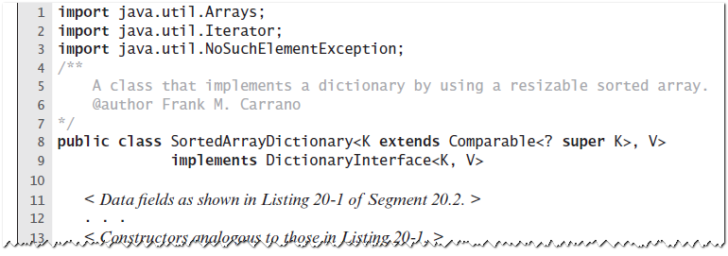
Sorted Array-Based Dictionary
LISTING 20-2 An outline of the class SortedArrayDictionary

Slide 43
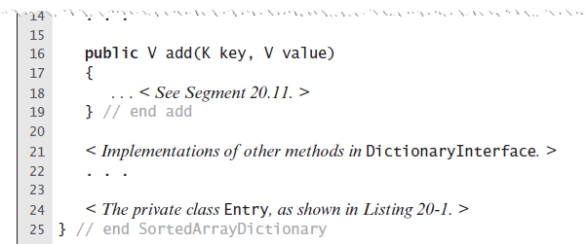
Sorted Array-Based Dictionary
LISTING 20-2 An outline of the class SortedArrayDictionary

Slide 44
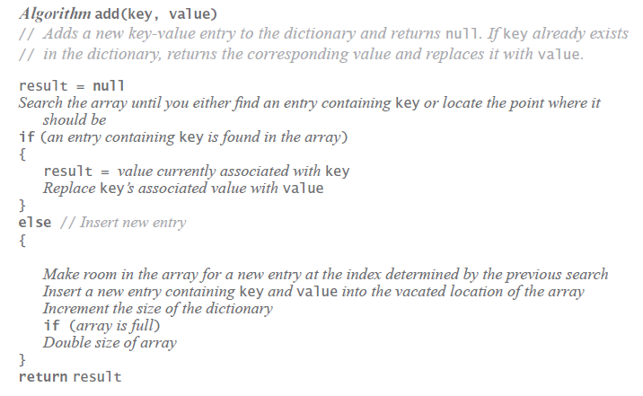
Sorted Array-Based Dictionary
Algorithm for adding an entry

Slide 45
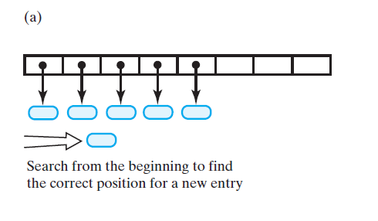
Sorted Array-Based Dictionary
FIGURE 20-4 Adding an entry to a sorted array-based dictionary: (a) search

Slide 46
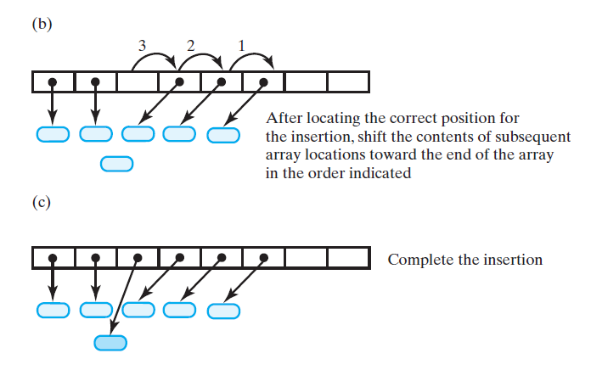
Sorted Array-Based Dictionary
FIGURE 20-4 Adding an entry to a sorted array-based dictionary: (b) make room; (c) insert

Slide 47
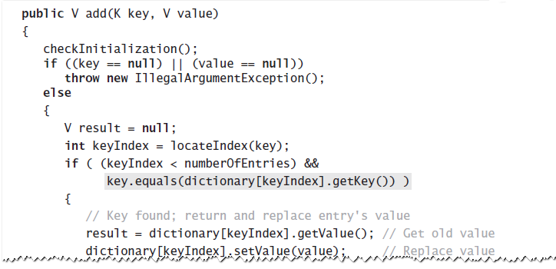
Sorted Array-Based Dictionary
Implementation of method add.

Slide 48
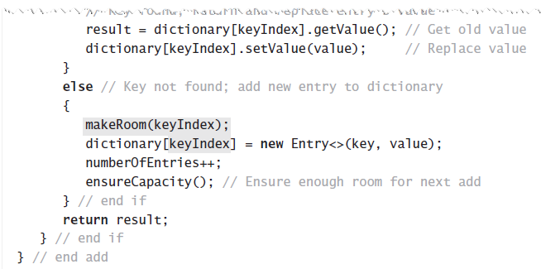
Sorted Array-Based Dictionary
Implementation of method add.

Slide 49
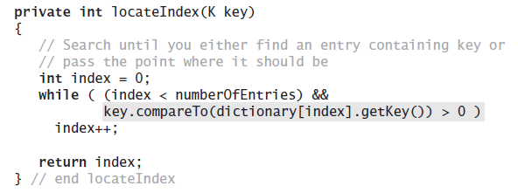
Sorted Array-Based Dictionary
Definition of the private method locateIndex

Slide 50
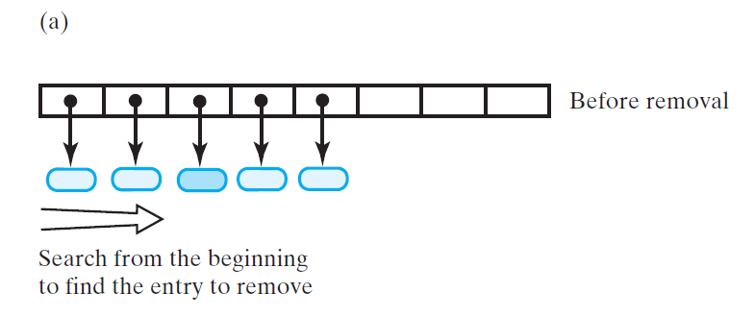
Sorted Array-Based Dictionary
FIGURE 20-5 Removing an entry from a sorted array-based dictionary: (a) search;

Slide 51
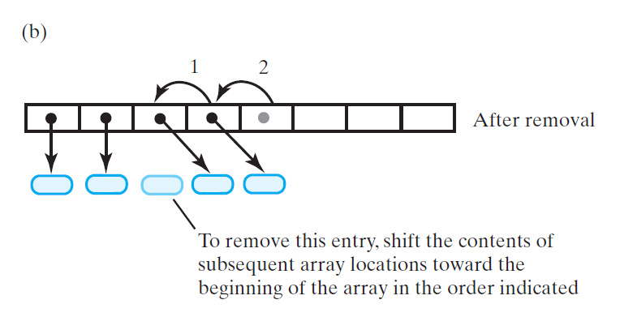
Sorted Array-Based Dictionary
FIGURE 20-5 Removing an entry from a sorted array-based dictionary: (b) shift entries

Slide 52
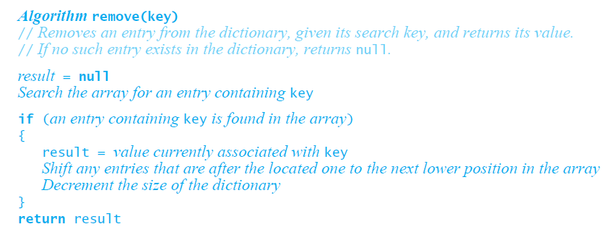
Sorted Array-Based Dictionary
Algorithm that describes the remove operation

Slide 53
Sorted Array-Based Dictionary
Efficiency. When locateIndex uses a binary search in the sorted array-based implementation, the worst-case efficiencies
Addition O(n)
Removal O(n)
Retrieval O(log n)
Traversal O(n)

Slide 54
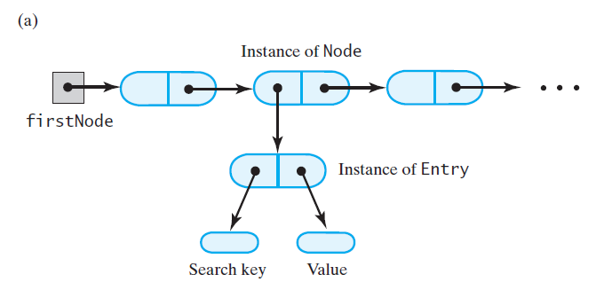
Linked Implementations
FIGURE 20-6 Three possible ways to use linked nodes to represent the entries in a dictionary: (a) a chain of nodes that each reference an entry object

Slide 55
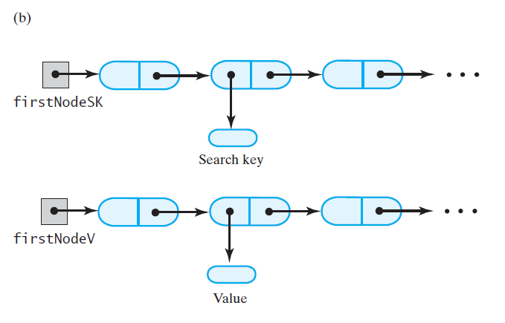
Linked Implementations
FIGURE 20-6 Three possible ways to use linked nodes to represent the entries in a dictionary: (b) parallel chains of search keys and values;

Slide 56
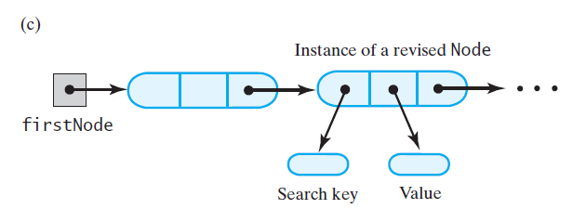
Linked Implementations
FIGURE 20-6 Three possible ways to use linked nodes to represent the entries in a dictionary: (c) a chain of nodes that each reference a search key and a value

Slide 57
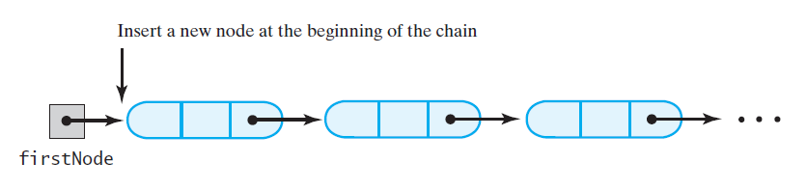
An Unsorted Linked Dictionary
FIGURE 20-7 Adding to an unsorted linked dictionary

Slide 58
Linked Dictionary
Efficiency: for this implementation, the worst-case efficiencies of the operations.
Addition O(n)
Removal O(n)
Retrieval O(n)
Traversal O(n)

Slide 59
END

